Slide 1
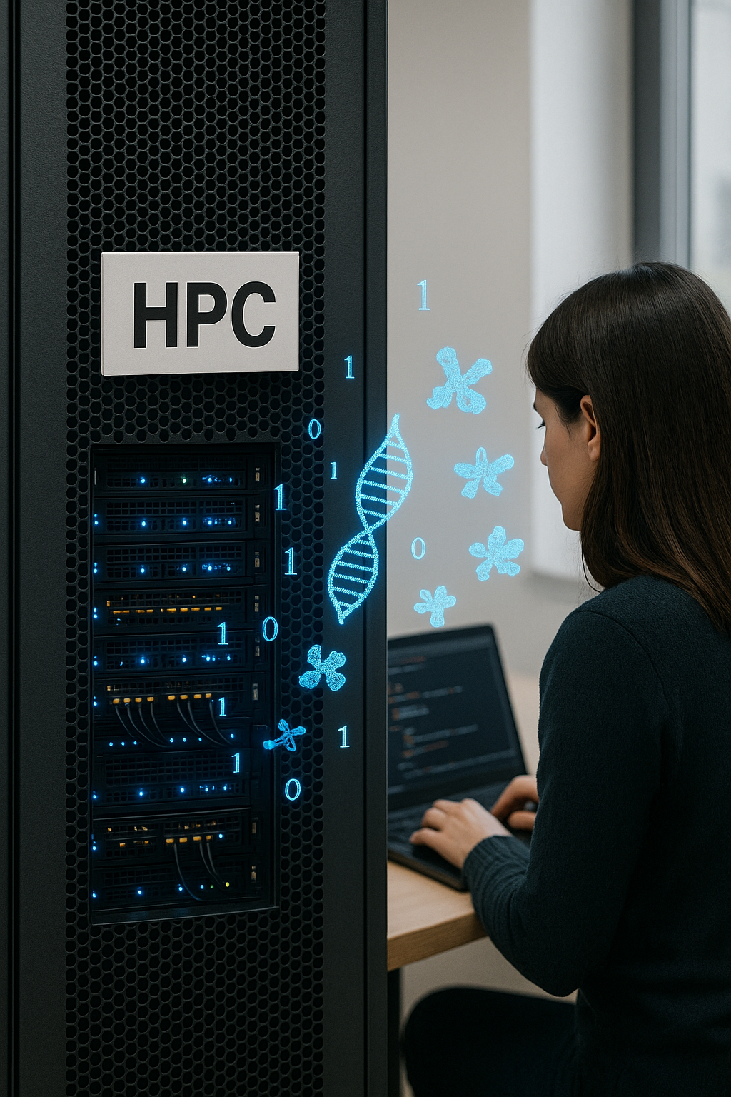

Software Management and Containers in HPC
Pablo Mata Aroco - BU-ISCIII
29-04 de octubre de 2025
1ª edición

Slide 2
Overview
Software management basics.
Software managers: EasyBuild, Conda-Mamba
Introduction to Virtualization. Containers: Docker & Singularity

Slide 3
Overview
Software management basics
Software managers: EasyBuild, Conda-Micromamba
Introduction to Virtualization. Containers: Docker & Singularity

Slide 4
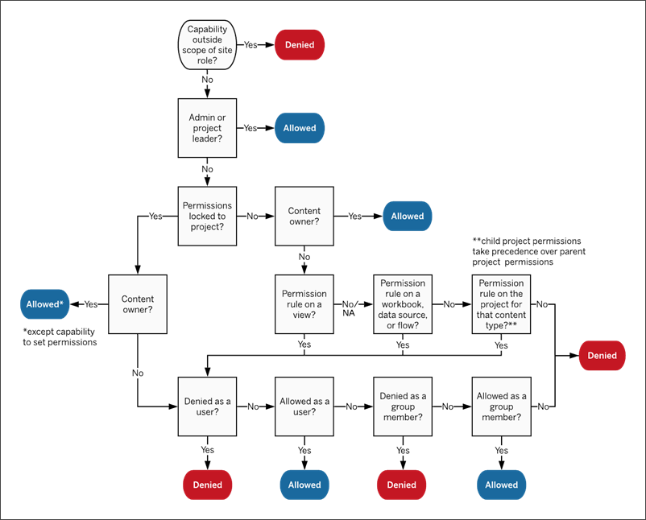
Software management basics: Permissions
Permissions are rules that control what a user can do on a computer system. They determine:
Who can read (view a file or program).
Who can write (modify or delete).
Who can execute (run a program).

Slide 5





Software management basics: Permissions
They exist to protect the operating system, applications, and data from accidental damage or malicious use:
Security: Prevent malware or mistakes from harming other users.
Stability: Prevent one user’s bad installation from breaking shared applications.
Consistency: Admins control which versions of software are installed cluster-wide.
Performance: HPC software often needs to be built with optimized compilers and libraries.
No-admin
Install Critical Software

Slide 6
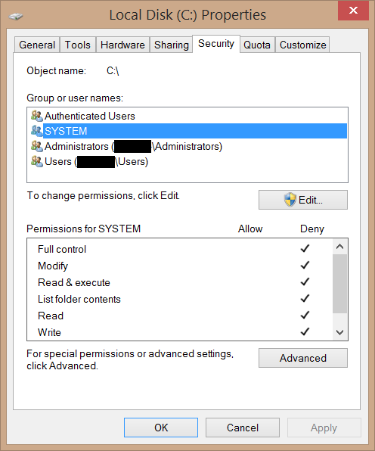
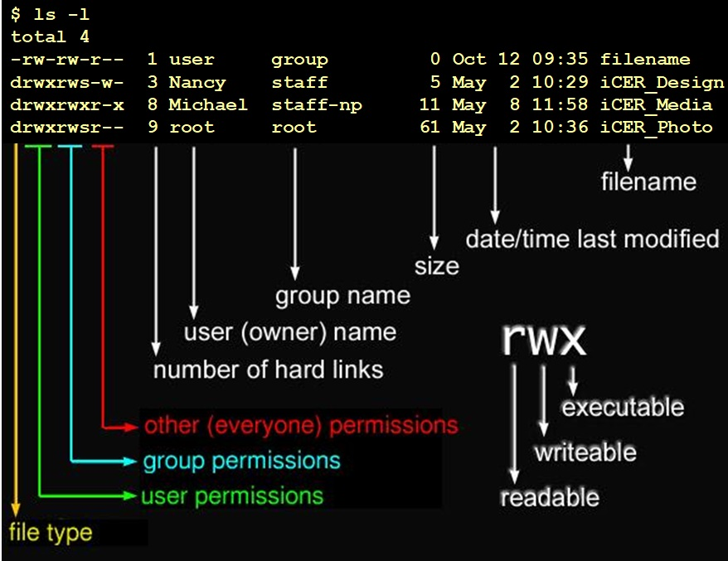
Software management basics: Windows vs Linux
Windows
Linux

Slide 7
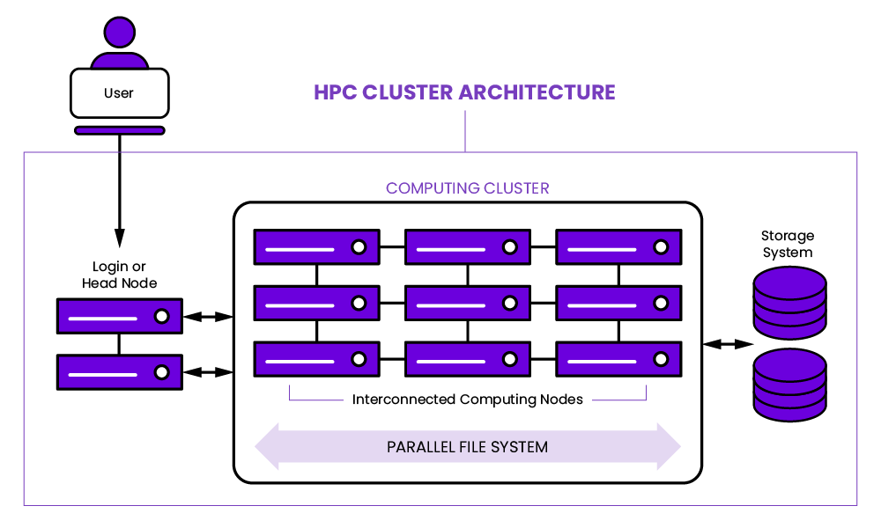
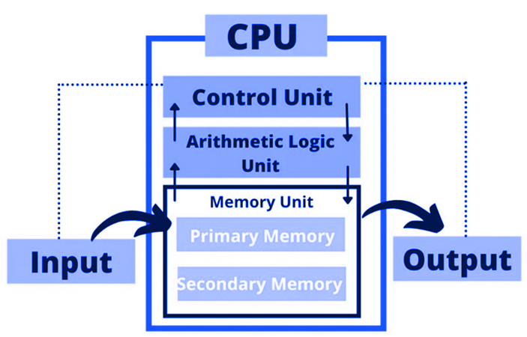
Software management: HPC vs Personal PC
(Admin permissions)
On a personal computer (for example, your Windows laptop) installing software is straightforward:
You open a browser, download an installer (.exe or .msi), run it, and the program installs locally.
You usually have administrator rights (even if you don’t notice), so you can change almost any system configuration.
You work on a single machine, with a fixed operating system and hardware (CPU, RAM, graphics card…).
PERSONAL PC ARCHITECTURE

Slide 8
Software management: HPC vs Personal PC
On a High-Performance Computing (HPC) system, the situation is very different:
It’s a multi-user environment
The hardware consists of compute nodes that cannot be accessed by normal users
You have no root permissions: you cannot install software system-wide, change OS settings…
The goal is to optimize for the cluster hardware and ensure reproducibility, not just “get a program running”

Slide 9
Software management: HPC vs Personal PC
(Admin permissions)
PERSONAL PC ARCHITECTURE

Slide 10
Software management: HPC principles
On a personal machine, you can afford to “break” your setup and reinstall. On an HPC the situation is completely different:
Overwriting system libraries could break unrelated software for all the other users.
You must be able to reproduce exactly an analysis months or years later with the same configuration.
In case of unrestricted installation a malicious or careless user could install malware.
That’s why HPC systems:
Organize software into modules, virtual environments or containers so you can choose versions without interfering with others.
This latter approach also helps to keep reproducibility.
Contained privileges: Users are free to install packages only in their home or scratch directories, where they can’t affect other users.

Slide 11
Software management: HPC principles
1. Security Reasons
An HPC is a shared multi-user environment — dozens, hundreds, or even thousands of people run jobs on the same nodes. If everyone could install or modify system software freely, it would be a security nightmare.
Key security risks if installation were unrestricted:
Malware injection: A malicious or careless user could install software that steals credentials, mines cryptocurrency, or damages data.
Privilege escalation: If someone installs a program with a known vulnerability, attackers could exploit it to gain root access.
Tampering with trusted tools: If ssh, ls, or python were replaced with compromised versions, all users would be at risk.
Inadvertent breakage: Without bad intent, a user might overwrite a library with an incompatible version, causing other users’ jobs to crash.
Example:Imagine installing a Python library that silently sends computation results to an external server. On your laptop, you’d only risk your own data — on an HPC, you could leak other researchers’ sensitive datasets.

Slide 12
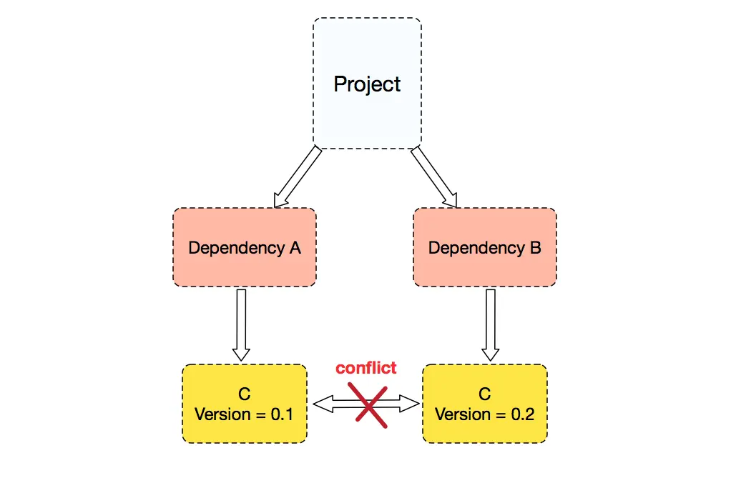
Software management: HPC principles
2. Maintainability Reasons
HPC admins have to maintain stability across hundreds of nodes, often for years.
Challenges if users installed software freely:
Version chaos: If every user installed different versions of gcc, cuda, or numpy in system directories, no one could guarantee reproducibility.
Dependency conflicts: Overwriting system libraries could break unrelated software

Slide 13
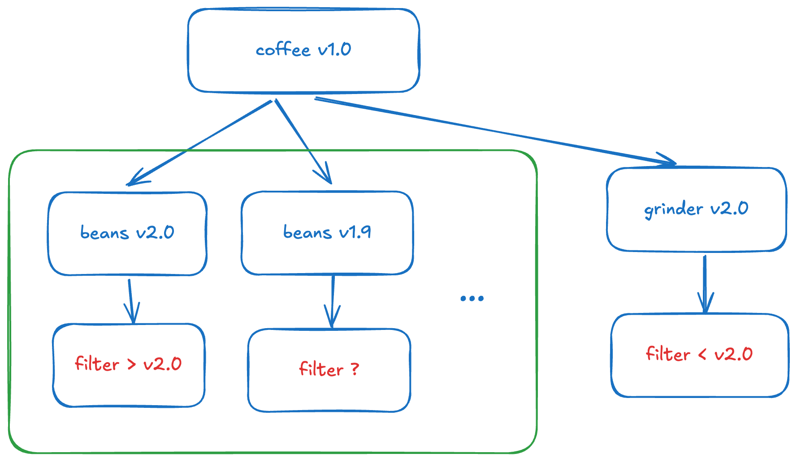
Software management: HPC principles
How admins handle it instead
Centralized software management: HPC teams use tools like EasyBuild or Spack to build and deploy software in a controlled way across all nodes.
Environment modules: Users load software via module load python/3.10 instead of installing it themselves.
User-space installations: Users are free to install packages in their home or scratch directories, where they can’t affect other users.
Containers: Singularity or Docker (where allowed) lets users run custom environments without touching the base system.

Slide 14
HPC vs Personal PC: Summary
Feature | Personal PC (Windows) | HPC
Simultaneous users | Typically one or a few, separate sessions | Dozens or hundreds of active users at the same time.
Permissions | User can install and modify system software | No root; install only in your home space
Software installation | Run graphical installers. No risk of conflict with other users. | Use modules, environment managers, or compile with tools like EasyBuild, Conda, Mamba
Hardware | Single CPU (multi-core), limited RAM | Multiple nodes, each with many cores and large memory; high-speed interconnect
Purpose | General use (office, games, etc.) | Large-scale data processing or computationally intensive tasks
Program execution | Run directly on your machine | Submit jobs to a scheduler/queue; executed on compute nodes
Updates | Automatic, controlled by the user | Planned by administrators to avoid disrupting jobs
Version management | Install or uninstall at will | Multiple versions coexist. You choose which to use

Slide 15
Overview
Software management basics.
Software managers: EasyBuild, Conda-Mamba
Introduction to Virtualization. Containers: Docker & Singularity

Slide 16
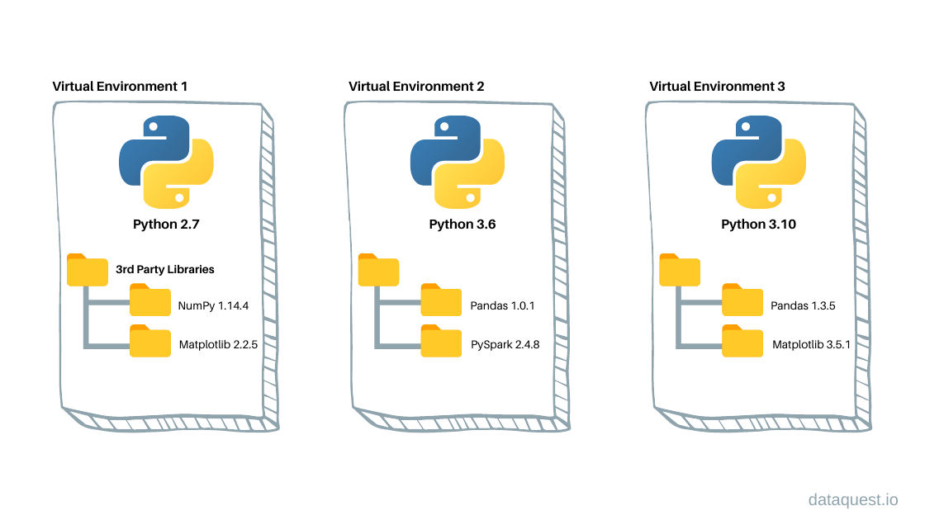
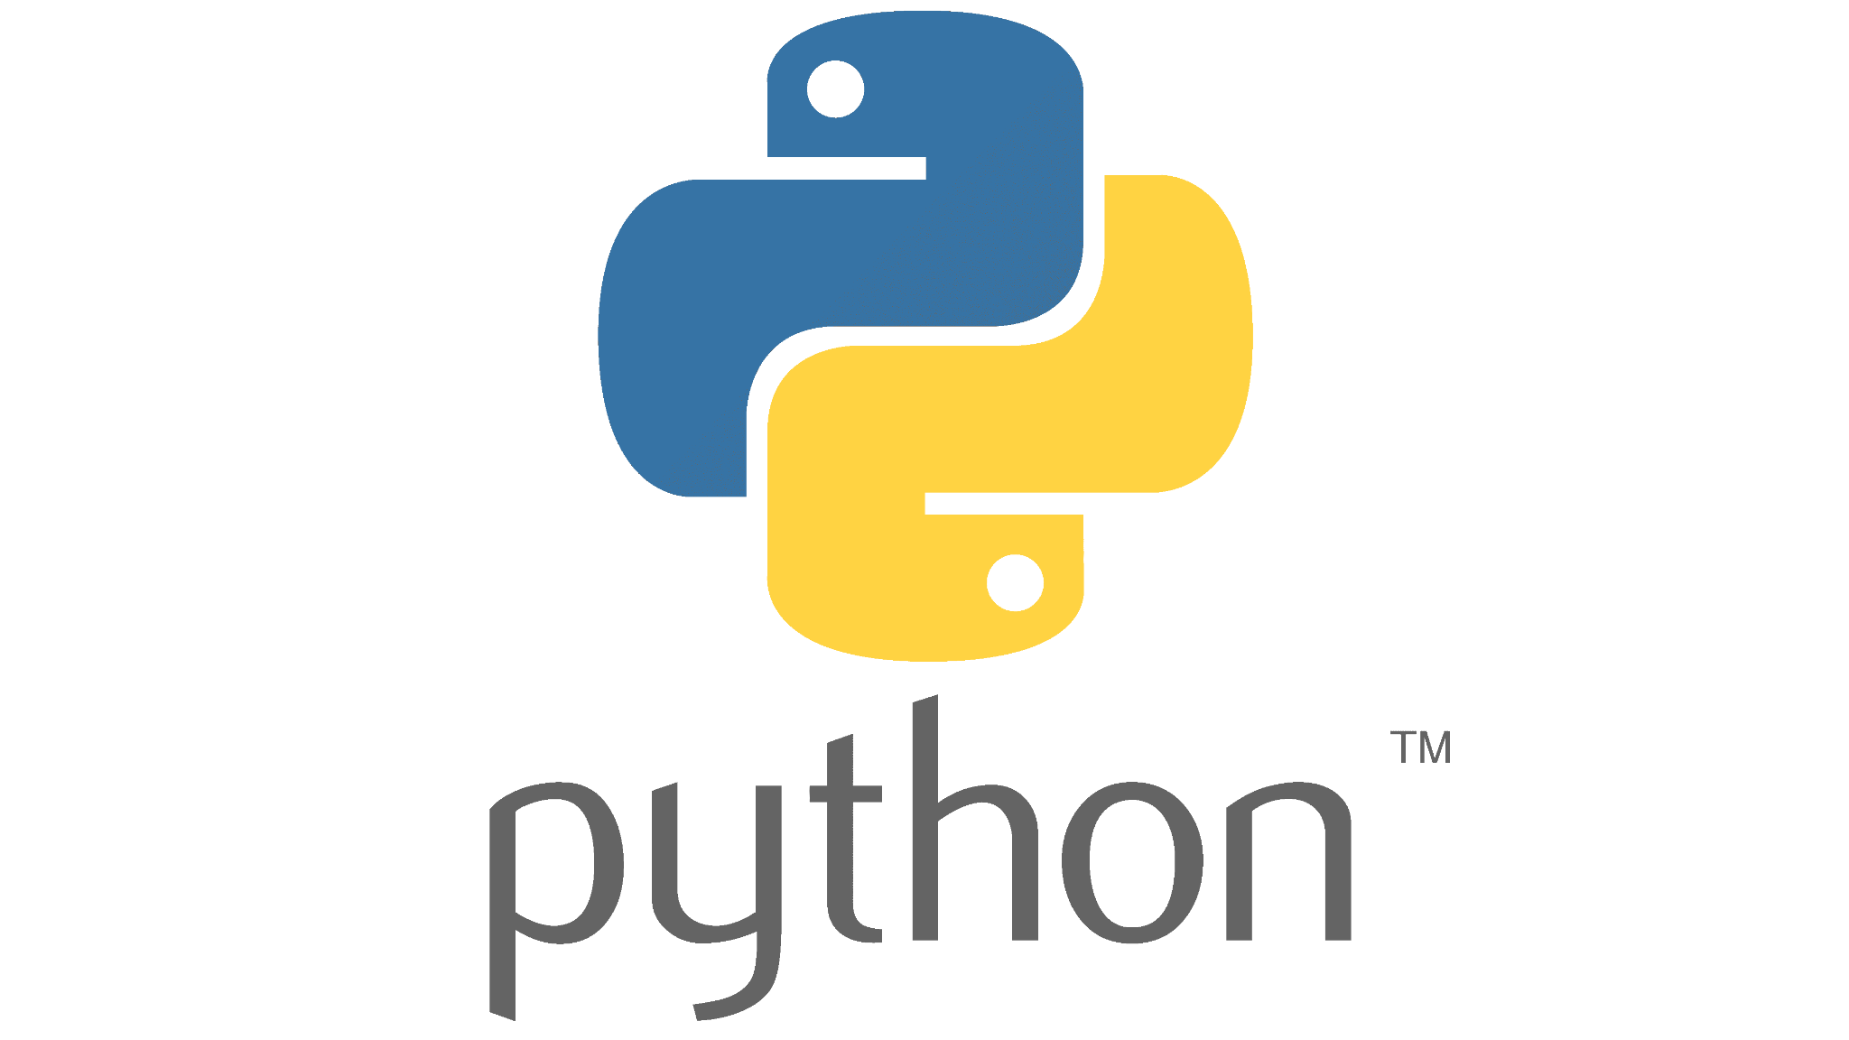
3. Introduction to virtualization: Virtual Environments
Virtual Environments.
A virtual environment is an isolated workspace on your computer where you can install software without interfering with the global system.
Examples: Python venv, Conda, Micromamba environments, R virtual libraries.
Pro: No root permissions needed.
Con: Doesn’t virtualize the OS, system or hardware. Only manages the software layer.
Root Installation

Slide 17
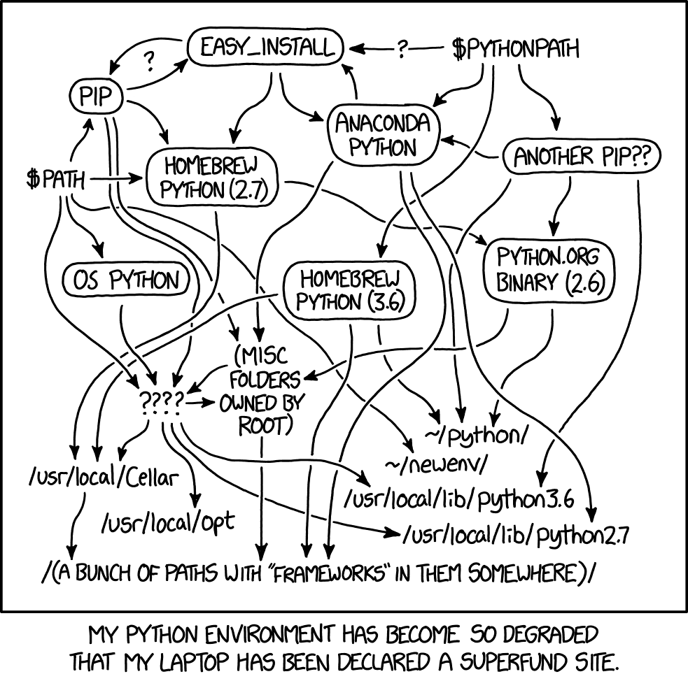

3. Introduction: Virtual Environments
Virtual Envs usage in HPC
On an HPC cluster, you usually don’t have admin/root permissions. That means:
You cannot install system-wide software (like pip install globally).
Users shares the same filesystem: installing packages globally would cause conflicts.
Even inside a virtual environment its difficult to avoid conflicts. Software managers exist for the sole reason to simplify this process.

Slide 18
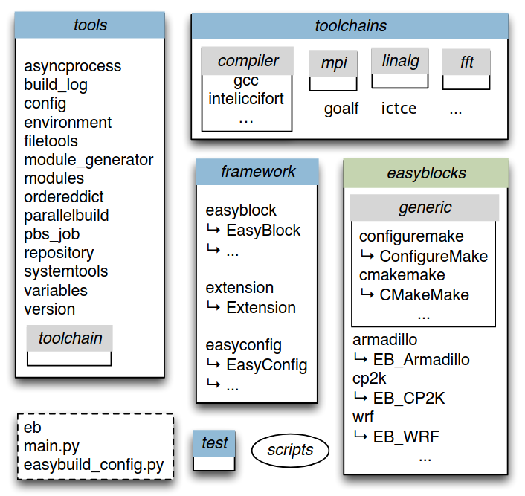
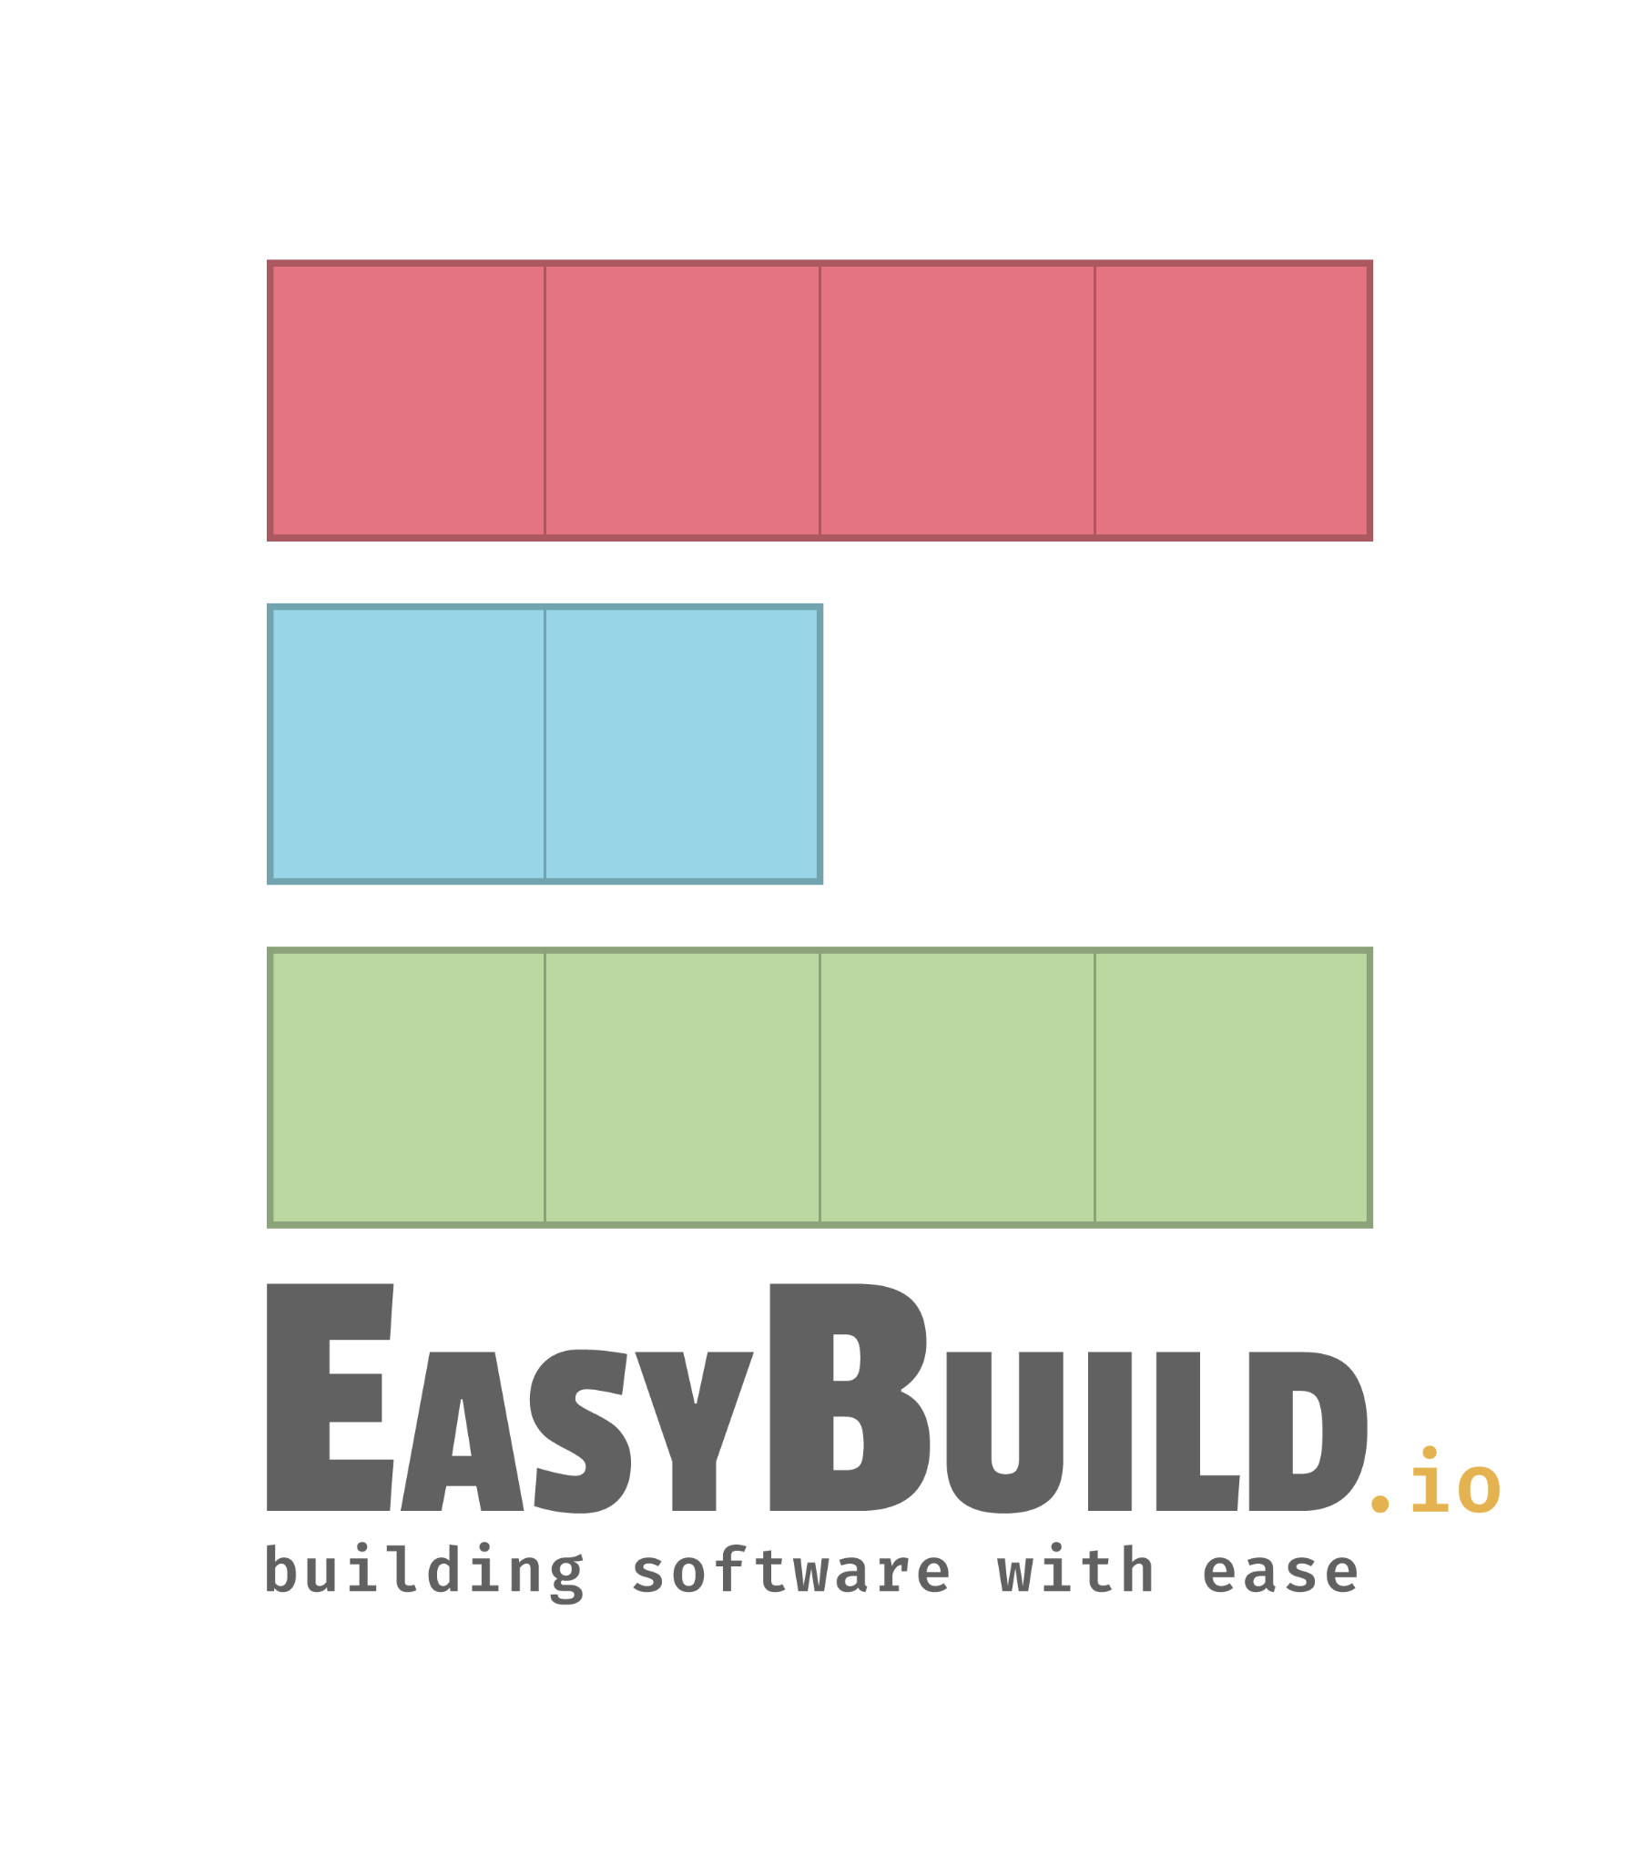
3. Software managers: EasyBuild
Easybuild.
EasyBuild is an open-source framework designed specifically for building and installing scientific software on HPC systems.
Our HPC uses this framework to manage certain global software for all users (e.g. Nextflow or singularity)
Encapsulates software in modules, which can be loaded via: module load <module-name>

Slide 19
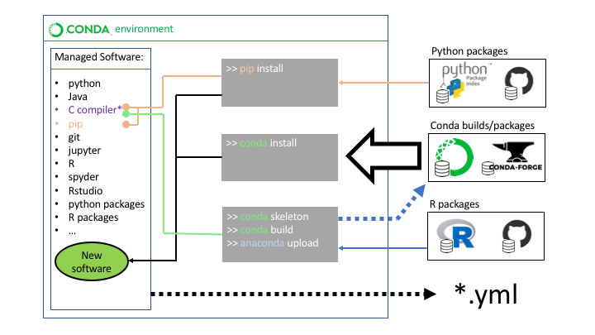
3. Software managers: Conda/Mamba
3. Virtual Environments (Software-Level)
Pro: No root permissions needed, isolates packages and dependencies inside the same OS without affecting system installations.
Con: Doesn’t virtualize the OS, system or hardware. Only manages the software layer.
HPC usage: Extremely common for running different Python/R environments on shared clusters without interfering with system-wide libraries.
Example: Python venv, Conda, Micromamba environments, R virtual libraries.

Slide 20
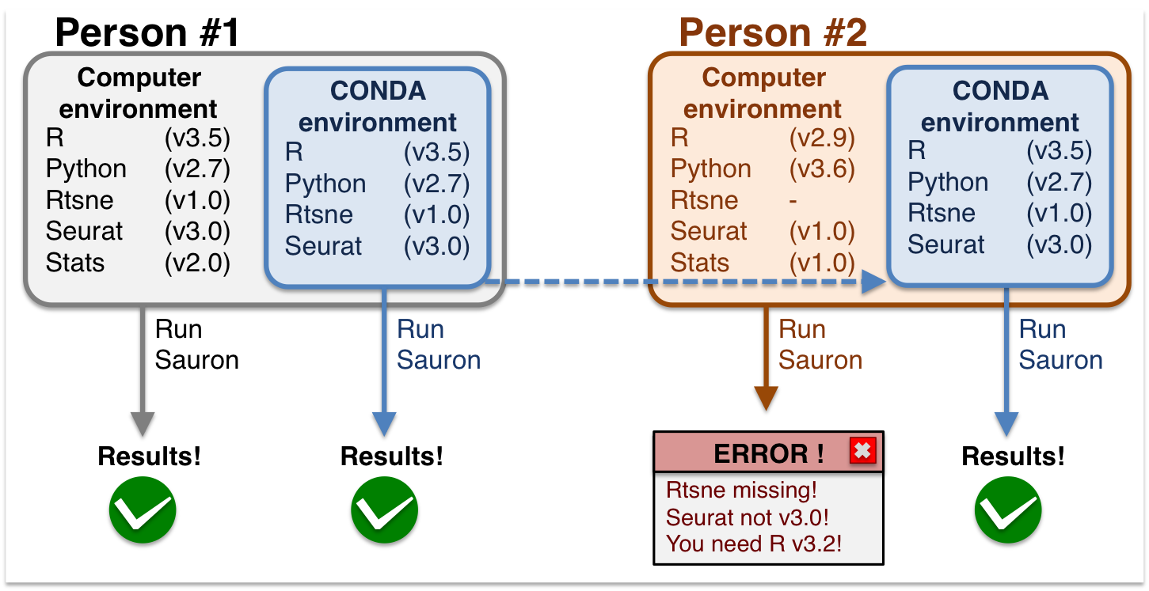
3. Software managers: Conda
Conda
Conda is a package/environment manager. Originally created for Python but works with any language (R, C/C++, Fortran…).
Creates isolated environments, each with its own Python/Language version and libraries.
Manages dependencies: ensures all required libraries are installed in compatible versions.

Slide 21
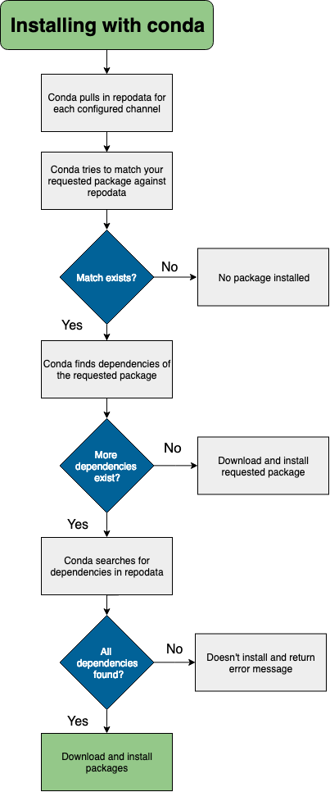
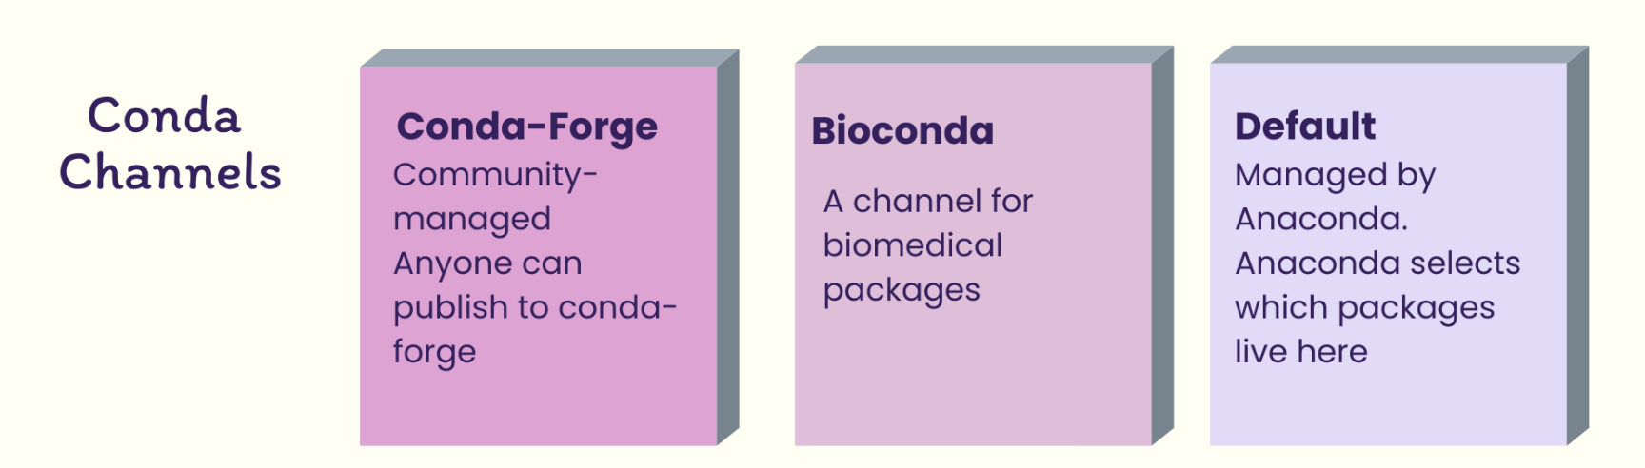
3. Software managers: Conda
Install with conda. Channels
Not everything can be installed with conda install. The desired software must be accessed through a conda channel
Conda channels are repositories (URLs) where Conda looks for packages.
The base channel is defaults, but there are community-driven channels like conda-force or bioconda. Anyone can create a channel.

Slide 22
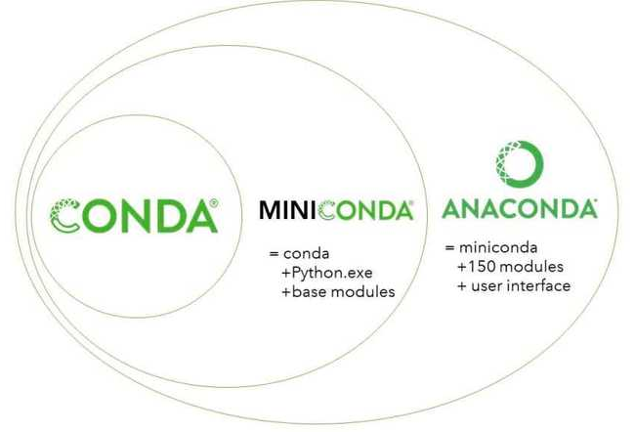



3. Software managers: Mamba
Mamba
A drop-in replacement for Conda written in C++ instead of Python.
Uses the same package repositories and commands as Conda.
Designed to solve Conda’s main weakness: slowness, specially in dependency resolution.
Micromamba: A lightweight (10mb), and self-contained version of mamba (installed in our HPC).

Slide 23



3. HPC shared environments
HPC shared virtual envs
If each user creates its own environments in the HPC, there may be differences in results due to software versions.
Using shared environments avoids differences in analysis results due to environment differences.
In our HPC, all users can access the same modules, for softwares like Nextflow or Singularity
You can also change conda’s configuration file (.condarc) to use the same list of environments as other users.
User 1
Private Conda envs
.condarc
User 2
Shared Conda envs
.condarc
Private Conda envs

Slide 24
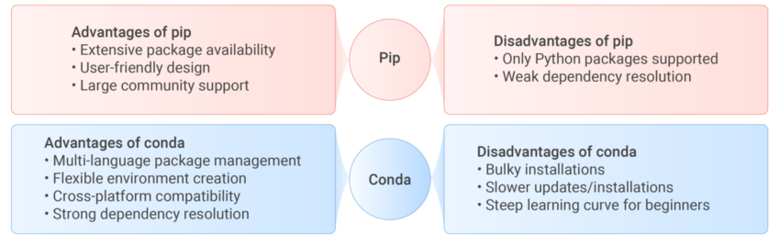
3. Other package managers: Pip
Pip
Pip is the default package manager for Python. It is the official tool for installing packages from the Python Package Index (https://pypi.org/), which holds a vast catalogue of packages.
Pip's sole purpose is to install, update, and remove Python packages from PyPI. Nonetheless, it can install binary packages (wheels) or software from source.
Pip itself does not have built-in environment management like conda, but you can install it in a conda environment.

Slide 25
Overview
Software management basics.
Software managers: EasyBuild, Conda-Mamba
Introduction to Virtualization. Containers: Docker & Singularity

Slide 26
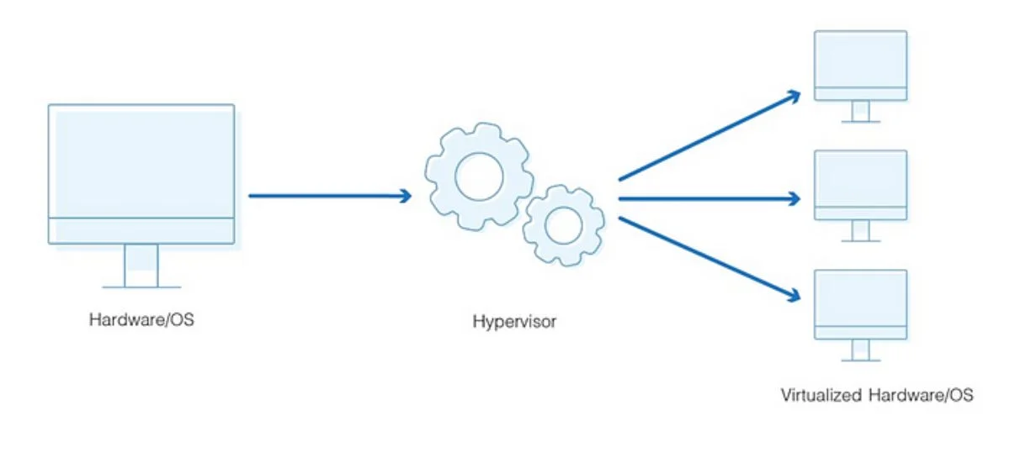
3. Introduction to virtualization
What is Virtualization?
Virtualization is the process of creating a virtual version of a computing resource.
It behaves like the real thing, but is actually a software on top of physical hardware.
Instead of interacting directly with the physical server, you interact with a virtual replica that is isolated from your system.

Slide 27
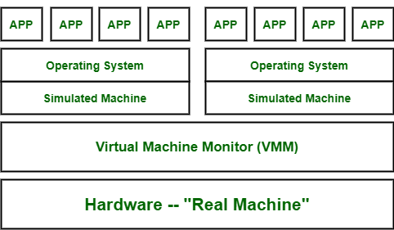
3. Introduction to virtualization: Virtual Machines
A. Full Virtual Machines
A Virtual Machine (VM) is a software-based emulation of a physical computer, including OS and hardware components using a hypervisor.
Pro: Total isolation. They can run a completely different operating system.
Con: Very slow due to full hardware emulation.
HPC usage: Rare, mainly for testing environments or isolated, security-sensitive workloads.
Example: Running Ubuntu in VirtualBox on a Windows laptop.

Slide 28
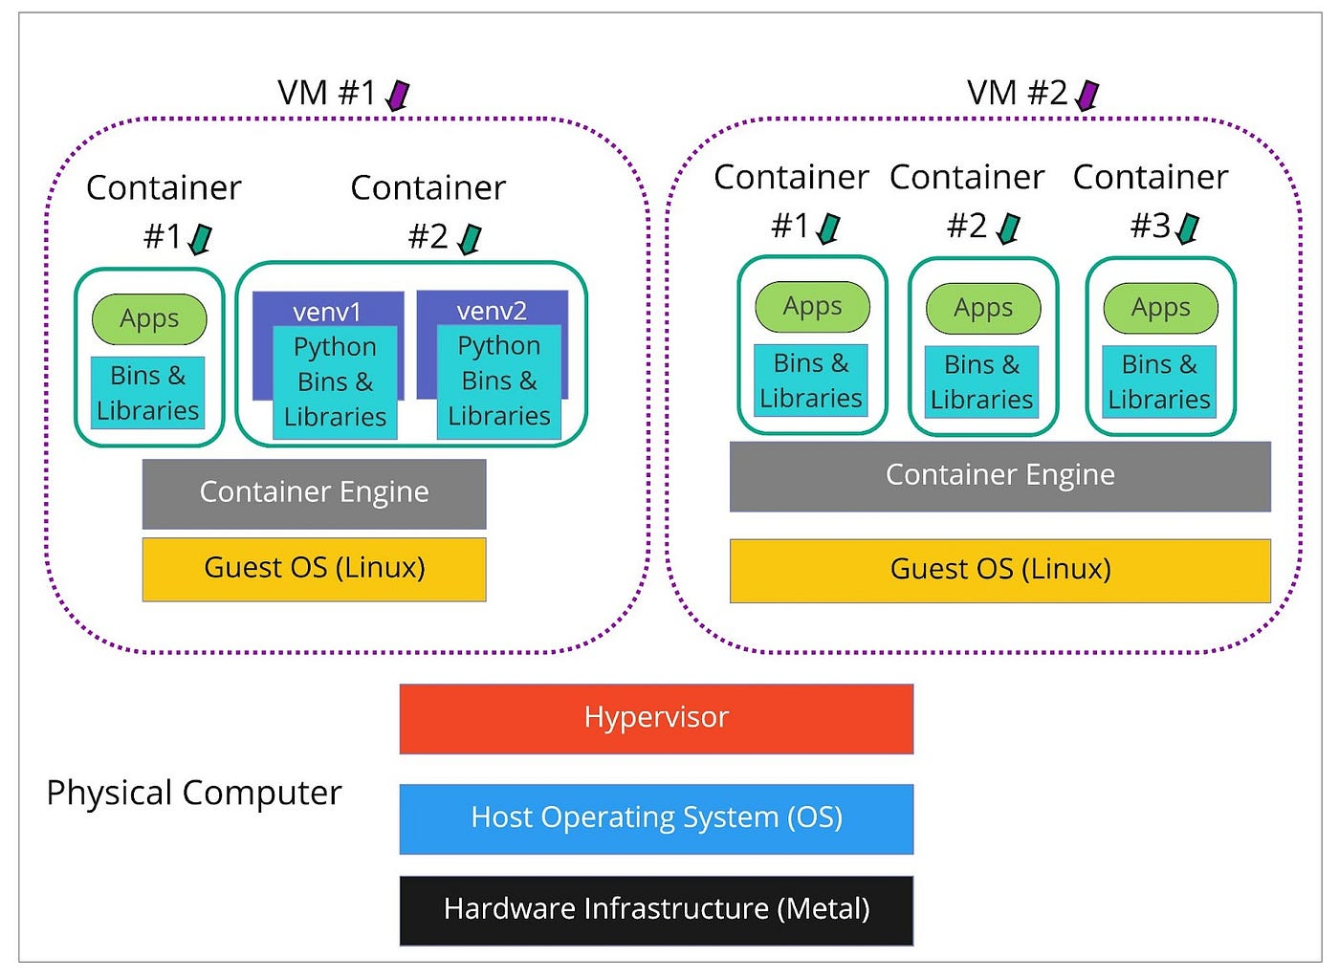
3. Introduction to virtualization: Containers
B. OS-level Virtualization (Containers)
A container is a lightweight, standalone package that bundles together an application and everything it needs to run, but shares the host system’s kernel instead of emulating hardware.
Pro: Near-native performance, lightweight.
Con: Shares the host OS kernel, cannot simulate a different OS than the host’s.
HPC usage: Very common for packaging software to run without dependency issues.
Examples: Docker, Singularity.

Slide 29
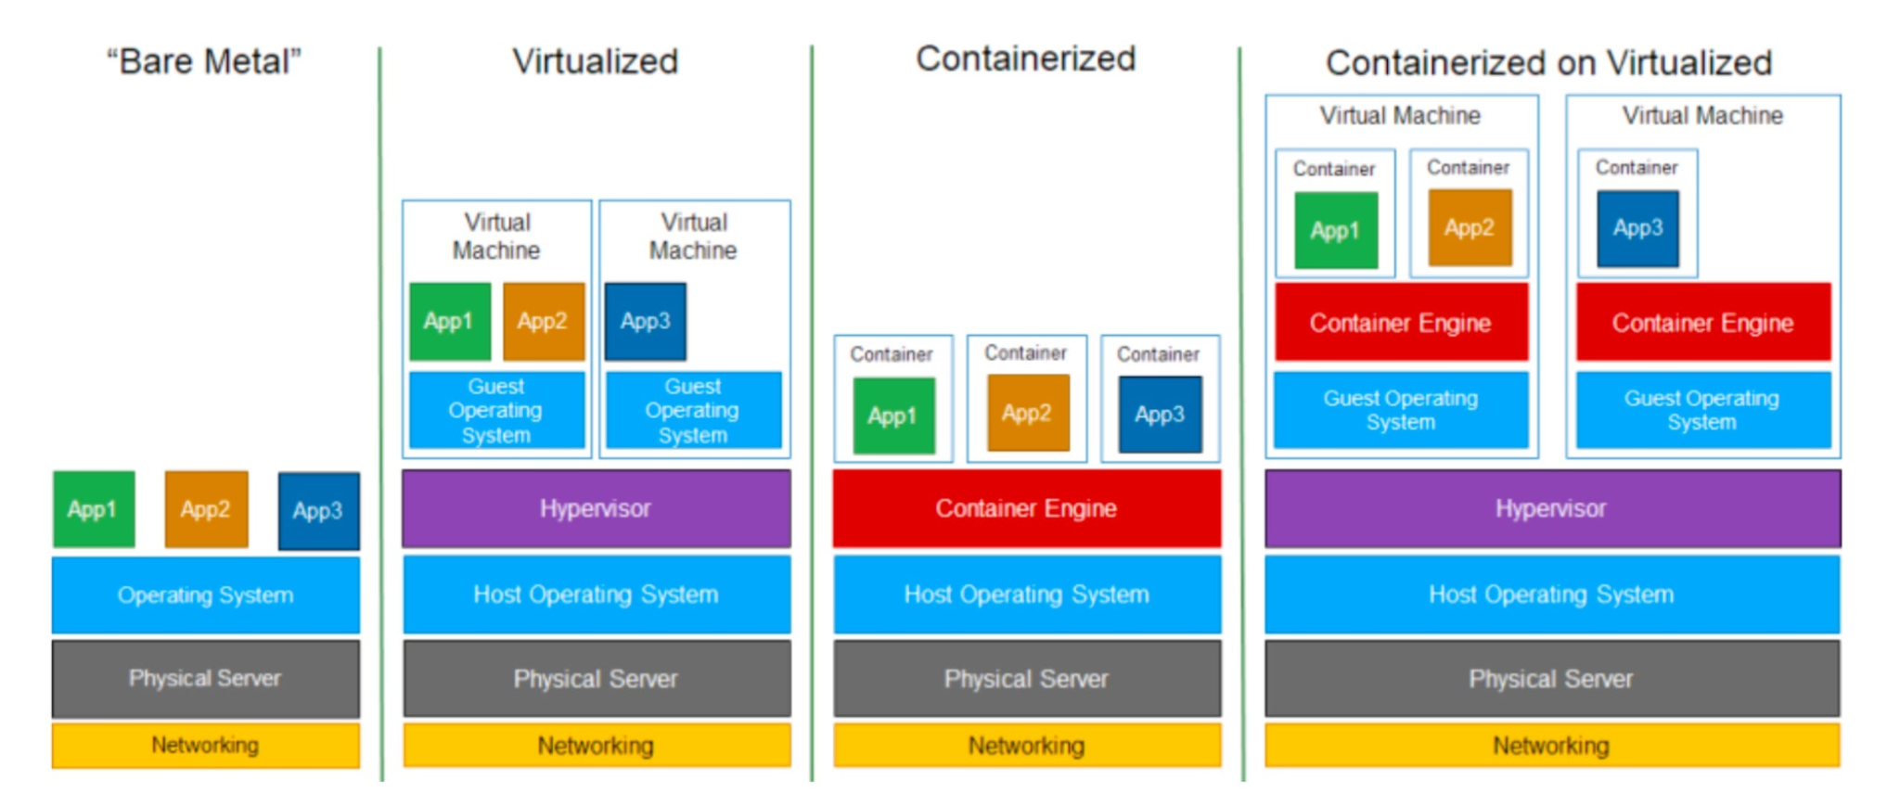
3. Introduction to virtualization: VMs vs Containers

Slide 30
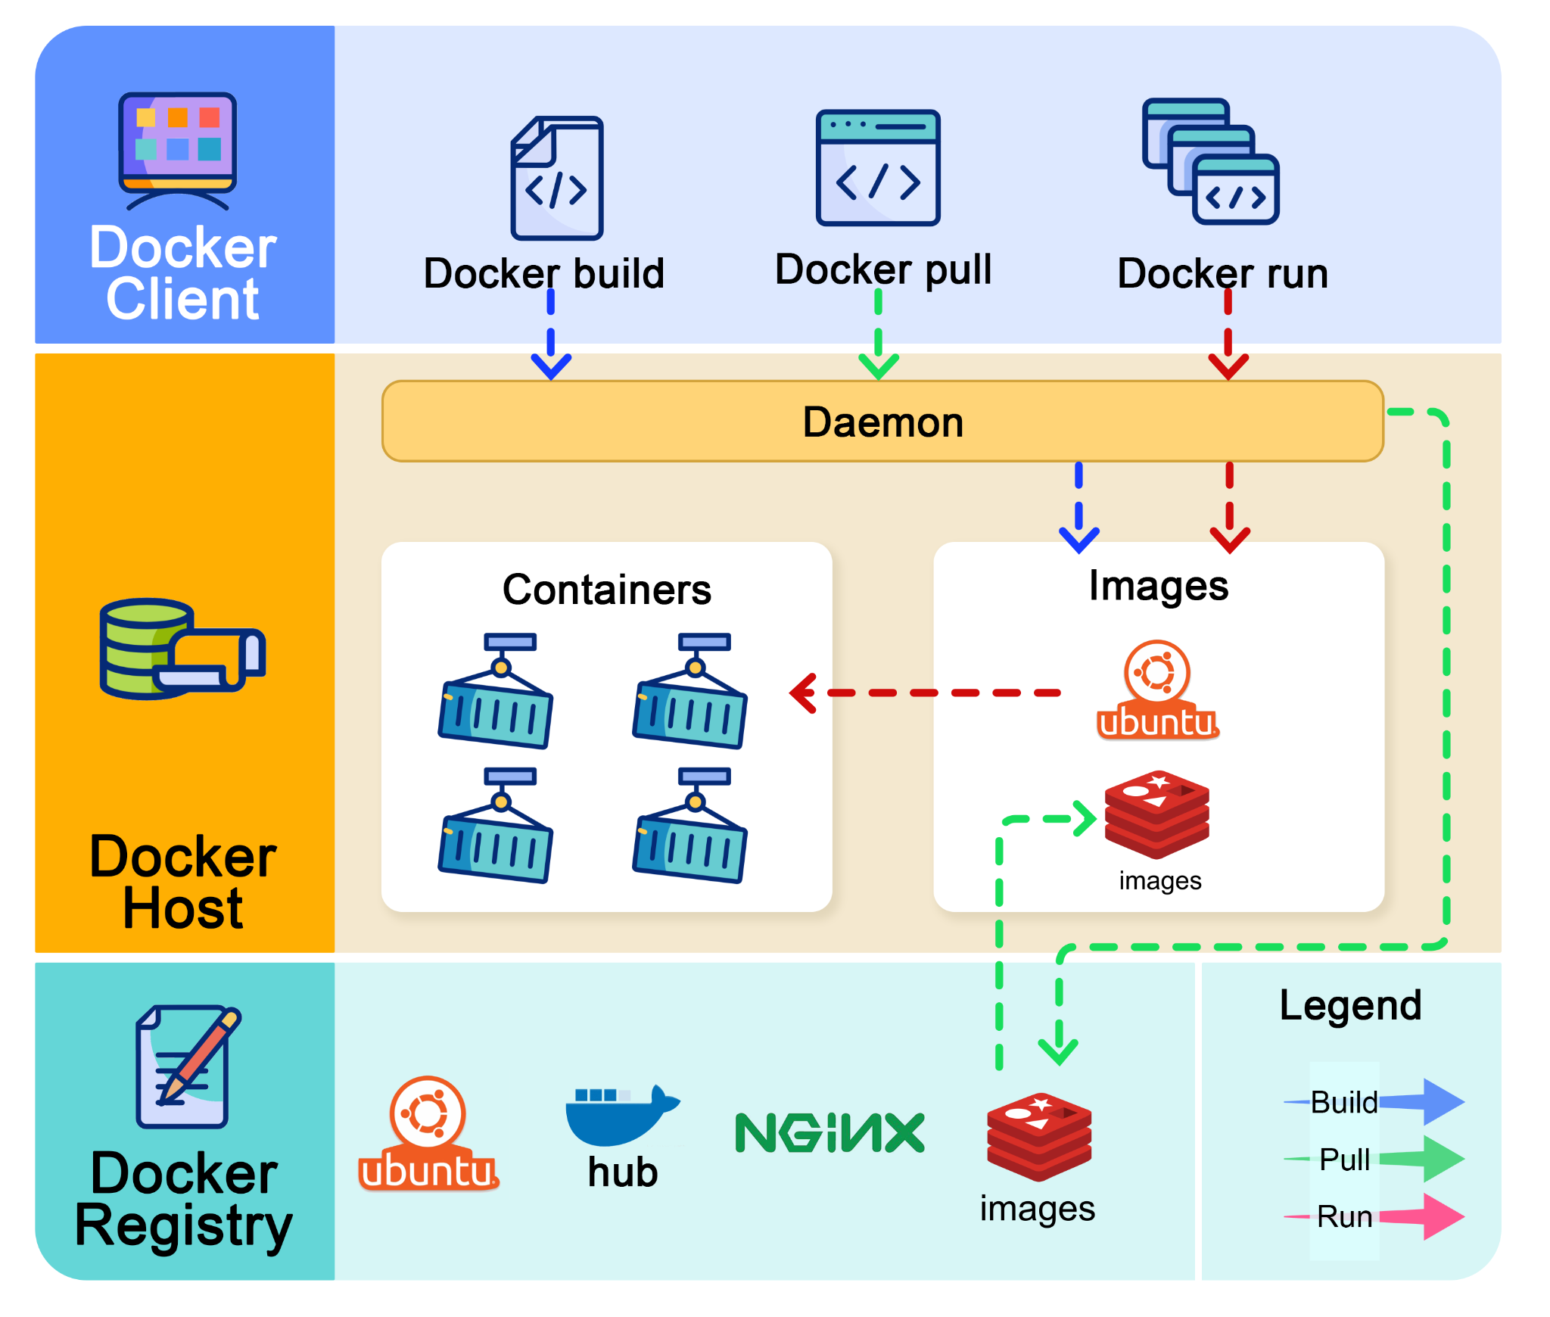
4. Introduction to containers: Docker & Singularity
Docker
Docker is a popular platform designed for building, sharing, and running applications in containers.
By default, Docker containers run as the root user on the host system. This can pose a security risk in multi-user environments like an HPC.
Unfortunately, we cannot directly use Docker in our HPC.

Slide 31
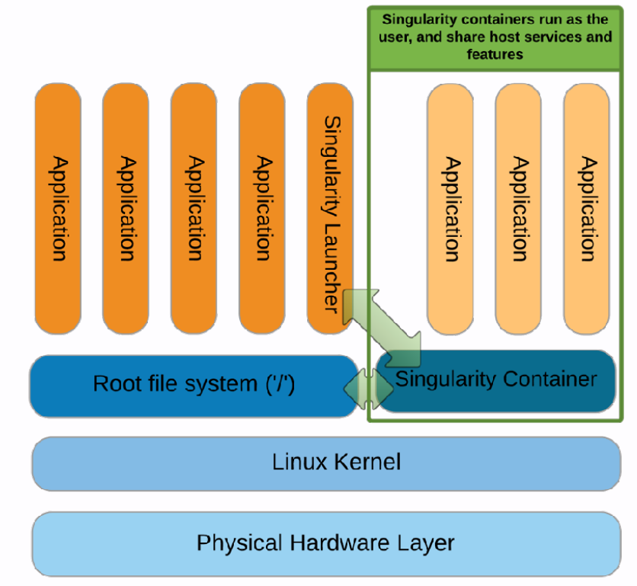
4. Introduction to containers: Docker & Singularity
Singularity
Singularity is a container platform specifically designed for high-performance computing (HPC) and scientific research environments.
Singularity containers run as the same user that launched them on the host system. This is a security feature for HPC clusters.
It's our go-to to create and run containers in the HPC
Galaxy’s https://depot.galaxyproject.org/singularity includes a lot of singularity containers for bioinformatic analysis:

Slide 32
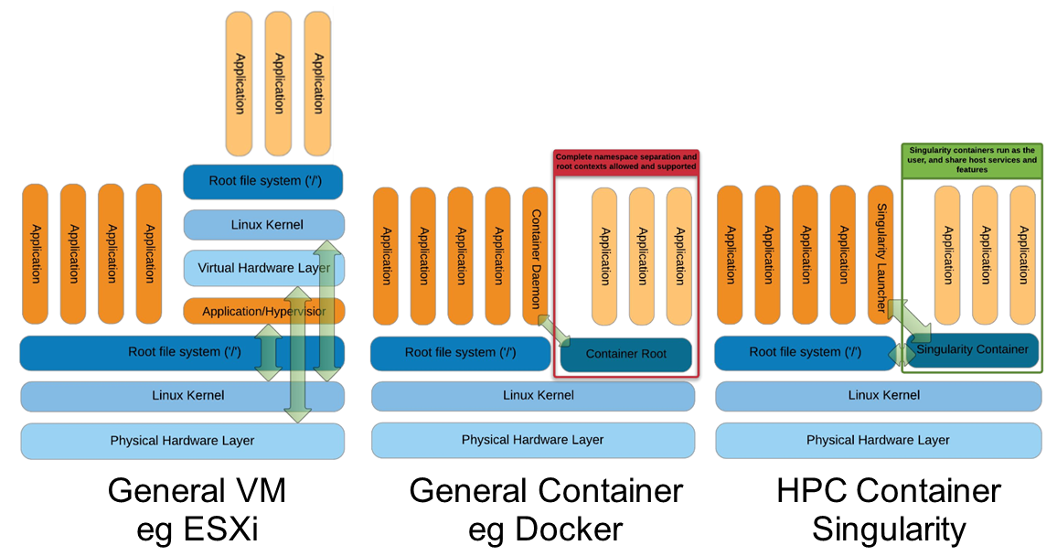
4. Introduction to containers: Docker & Singularity

Slide 33
Essential takeaways
You cannot install anything on the HPC that needs admin permissions.
Prioritize modules over virtual environments (More efficient)
If you only need to execute one certain task (e.g. run FastQC) use a singularity container
If you need to interact with files or data dynamically use virtual environments (Micromamba/Pip)
DON’T RUN HEAVY JOBS IN THE LOGIN NODE!!

Slide 34
Practical exercises
The best way to understand everything is with some hands-on exercises.

